Slide 1
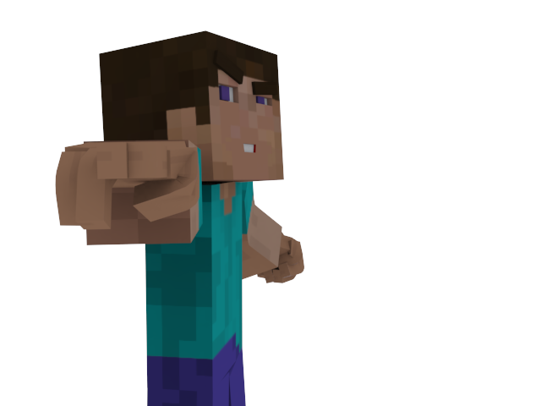
Zombie vs. Crafter Run
Copyright @ 2017, Socristal Pixel Studios
Soraya Casares, Cristal Cruz,Veronica Brown.

Slide 2
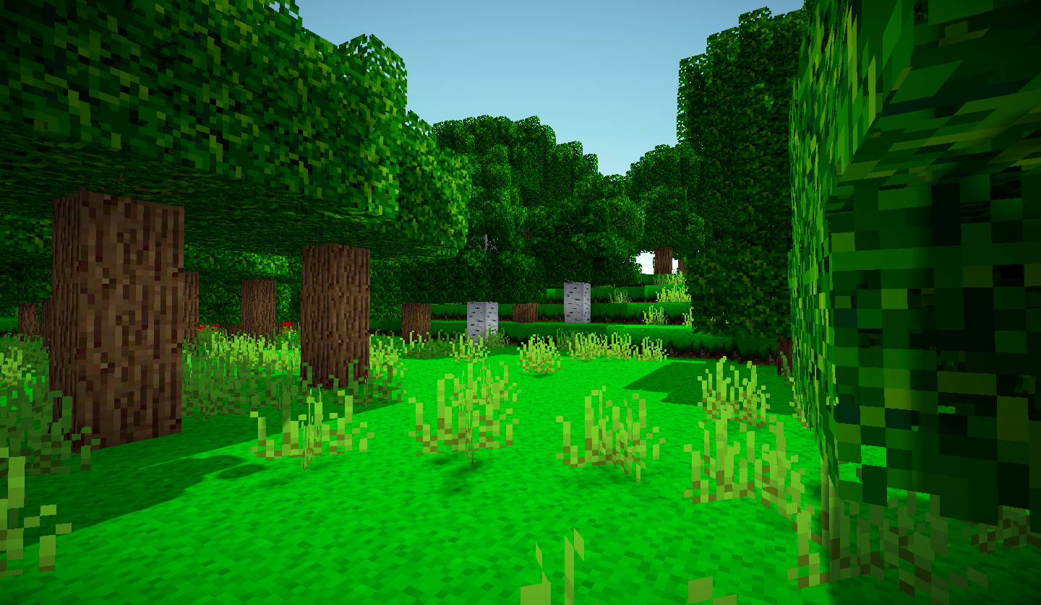
Notes:
Introduce both characters
2 player game
The idea of the game

Slide 3
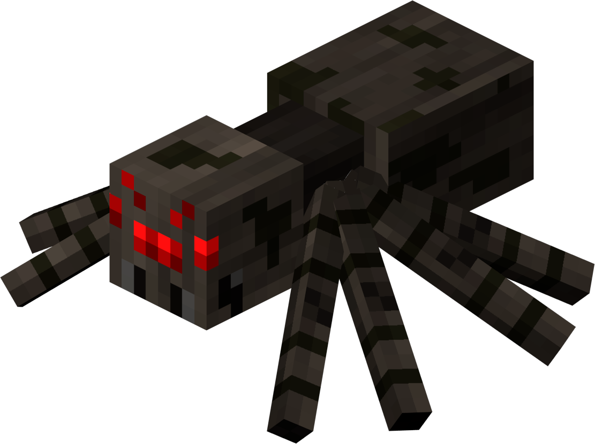

Notes:
What are the spiders for
Why do you avoid them and wich ones too avoid

Slide 4


Notes:
Health increasers
Which ones help u and which ones dont help you

